Slide 1
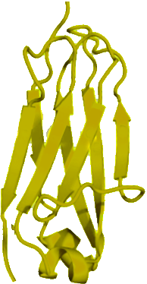
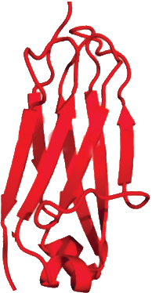
Heavy and Light Chains
Antibodies are large, multi-chain proteins, comprised of two heavy protein chains and two light protein chains.
Heavy and light chains can be further broken down into small modular motifs called Immunoglobulin Folds. Each heavy chain contains four immunoglobulin folds and each light chain contains two immunoglobulin folds.
Using the immunoglobulin fold pieces shown below, construct a single heavy chain and a single light chain to the right. When finished, move on to the next slide.

Slide 2
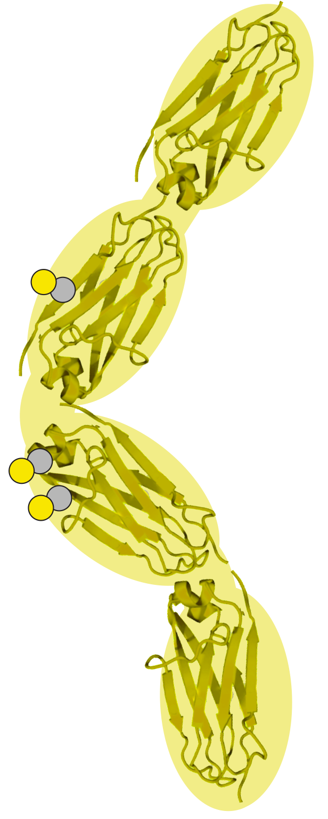
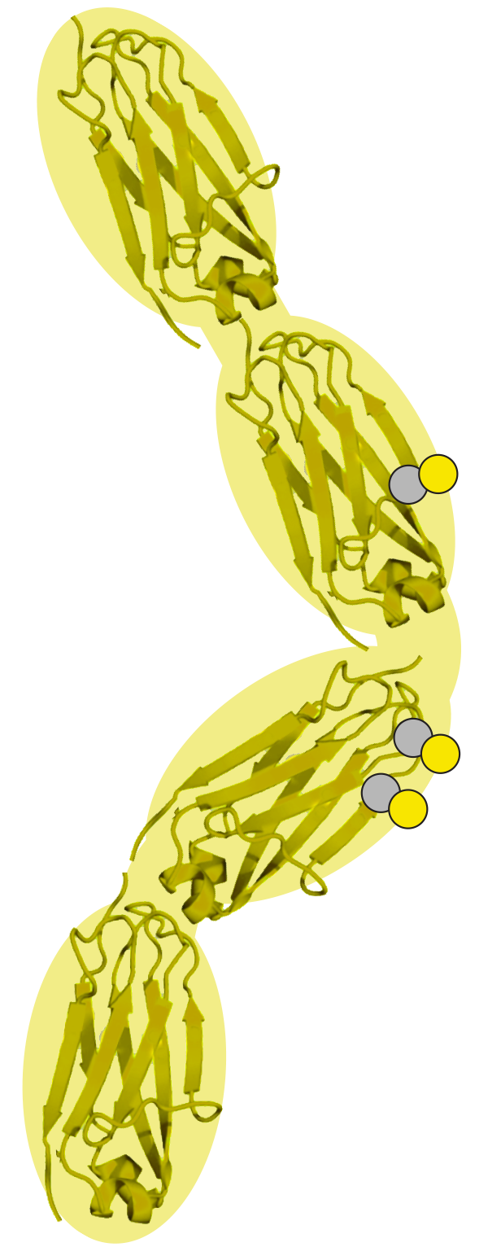
Assembling a Full Antibody
The two heavy protein chains and two light protein chains of an antibody come together in a very precise orientation that is stabilized by four key disulfide bonds between cysteine amino acids (gray and yellow).
Using the photo of an antibody model shown below as a guide, assemble the four chains shown to the right into a full antibody. When finished, move on to the next slide.

Slide 3
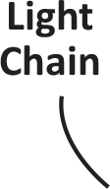
Labeling Your Antibody
As a review of the antibody you have assembled, add the labels to the right to the antibody graphic. Use the four green ovals to highlight the four disulfide bonds between cysteine amino acids.

